Slide 1
Data Science Process
Introduction to Data Science
https://sherbold.github.io/intro-to-data-science

Slide 2
Outline
Generic Process Model
Roles
Core Deliverables
Summary

Slide 3
Processes are Important
Techniques
Languages, tools, and methods
Must be suited for the given problem
People
Require training for the techniques
Should be guided through a project by a process
Process
Supports the people
Must be accepted by the people
Should have a measurable positive effect
Techniques
People
Processes

Slide 4



Process of Data Science Projects
Discovery
Operationalize
Data
Preparation
Communicate Results
Model Planning
Model Building

Slide 5































Slide 6
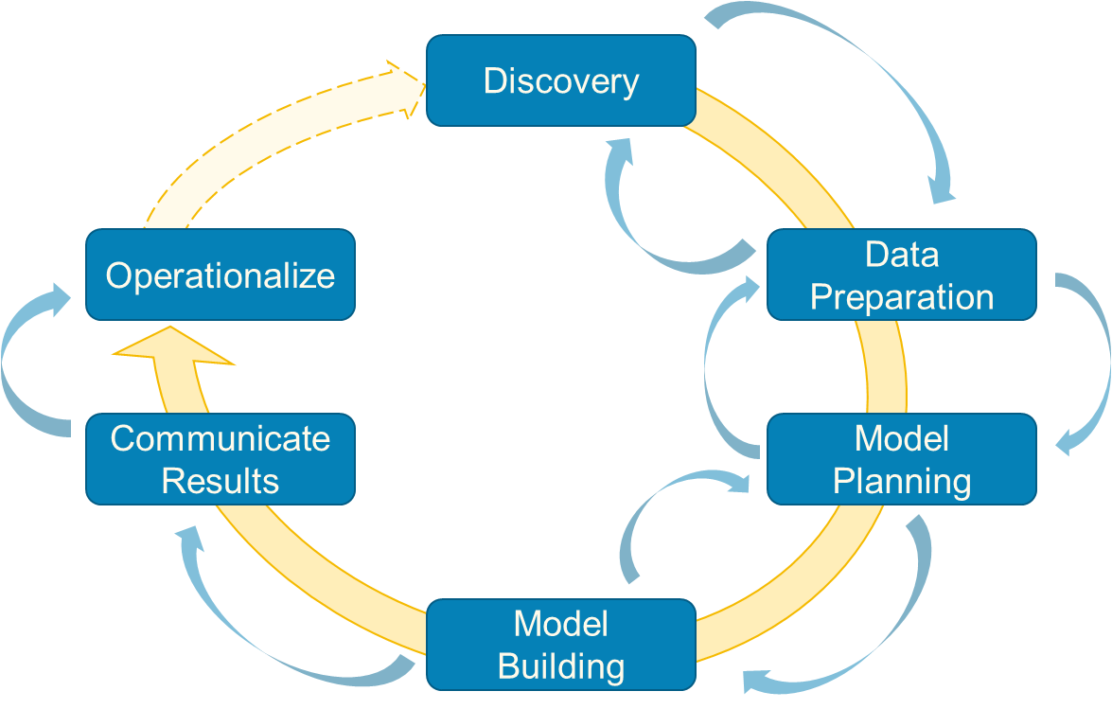
Discovery
Initial phase of the project
Learn the domain
Knowledge for understanding the data and the use cases of the project
Knowledge for the interpretation of the results
Learn from the past
Identify past projects on similar issues
Differences, reasons for failures, weaknesses of past projects
Can also be projects of competitors, if reports are available

Slide 7
Discovery
Frame the problem
Framing is the process of stating the data analysis problem to be solved
Why is the problem important?
Who are the key stakeholders and what are their interests in the project?
What is the current situation and what are pain points that motivate the project?
What are the objectives of the project?
Business needs
Research goals
What needs to be done to achieve the objectives?
What are success criteria for the project?
What are risks for the project?

Slide 8




Discovery
Begin learning the data
Get a high-level understanding of the data
Maybe even some initial statistics or visualizations of the data
Determine requirements for data structures and tools for processing the data
Formulate hypothesis
Part of the „Science“ in „Data Science“
Should define expectations
„Feature X is well suited for the prediction of …“
„The following patterns will be found in the data: …“
„Deep learning will outperform …“
„Decision trees will perform well and allow insights into …“
Should be discussed with stakeholders

Slide 9
Discovery
Analyze available resources
Technologies
Resources for computation and storage
Licenses for analysis frameworks
Data
Is the available data sufficient for the use case?
Would other data be required and could the additional data be collected within the scope of the project?
Timeframe
Scope in calendar time and person months
Human resources
Who is available for the project?
Is the skillset a good match for the tasks of the project?
→ Only start project if the resources are sufficient!

Slide 10
Data Preparation
Create the infrastructure for the project
Usually different from infrastructure in which data is made available to you
Warehouse/csv-file/… ←→ distributed storage that enables analysis
Could also be simpler, for small data sizes
Extract – Transform – Load (ETL) the data
Define how to query existing database to extract required data
Determine required transformations of the raw data
Quality checking (e.g., filtering of missing data, implausible data)
Structuring (e.g., for unstructured data, differences in data structures)
Conversions (e.g., timestamps, character encodings)
Load the data into your analysis environment

Slide 11










Slide 12
Data Preparation
ELT vs. ETL
Transformations can be very time-consuming for big data
Might not be possible without using the analysis infrastructure
Load raw data, transform afterwards → ELT!
Also allows more flexibility with transformations
E.g., testing the effect of different transformations
Allows access to raw data

Slide 13




Data Preparation
Get a deep understanding of the data
Understand all data sources
E.g., what does each column in a relational database contain?
How can a structure be imposed on semi-/quasi-/unstructured data?
Survey and visualize data
Descriptive statistics
Correlation analysis
Visualizations like histograms, density plots, pair-wise plots, etc.
Clean and normalize data
Discard data that is not required
Normalize to remove scale effects

Slide 14
















Slide 15
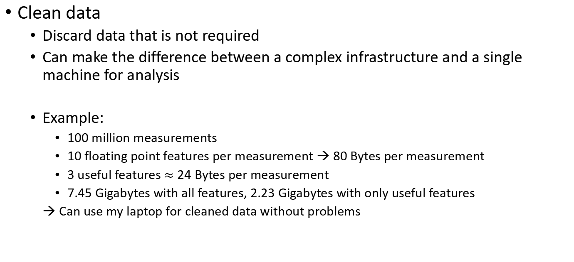
Data Preparation
Clean data
Discard data that is not required
Can make the difference between a complex infrastructure and a single machine for analysis
Example:
100 million measurements
10 floating point features per measurement → 80 Bytes per measurement
3 useful features $≈$ 24 Bytes per measurement
7.45 Gigabytes with all features, 2.23 Gigabytes with only useful features
→ Can use my laptop for cleaned data without problems

Slide 16

Model Planning
Determine methods for data analysis
Should be well-suited to meet objectives
Often determines the type of method
Classification, regression, clustering, association mining, …
Other factors can also restrict the available methods
For example, if insight is important, „blackbox“ methods cannot be used
Should be well-suited for the available data
Volume, structure, …
A blackbox method is a method where you only get results, but do not really understand why the output is computed that way.
A whitebox method also explains why the output is as it is.

Slide 17









Model Planning
Methods for data analysis may cover
Feature modeling, e.g., for text mining
Feature selection, e.g., based on information gain, correlations, etc.
Model creation, e.g., different models that may address the use case
Statistical methods, e.g., for the comparison of results
Visualizations, e.g., for the presentation of results
Split data into different data sets
Training data, validation data, test data
„Toy“ data for local use in case of big data
Same structure, but very small

Slide 18





Feature Modeling
Or
Feature Engineering

Slide 20





























Data Spilt

Slide 21



























Slide 22


Model Building
Perform the analysis using the planned methods
Often iterative process!
Separate phase, because this can be VERY time consuming
Use toy examples for model planning
Use real big data set with potentially lots of hyper parameters for tuning during model building
Includes the calculation of performance indicators

Slide 23
Communicate Results
Main question: Was the project successful? UA: User acceptance
Compare results to hypothesis from the discovery phase
Identify the key findings
Try to quantify the value of your results
Business value, e.g., the expected Return On Investment (ROI)
Advancement of the state of the art
Summarize findings for different audiences (technical & non-technical)

Slide 24
























Slide 25






Operationalize
Implement results in operation
Only in case of successful projects
Should run a pilot first
Determine if expectations hold during the practical application
All kinds of reasons for failures
Rejection by users, shift in data reduces model performance, ...
Define a process to update and retrain model
Data gets older, models get outdated
Data driven models should be updated regularly
Process is required

Slide 26
Data Science Process – detailed steps
Problem Definition
Data Collection and cleaning
Feature Engineering
Model Training
Model Evaluation
Data Exploration: Exploratory Data Analysis - EDA
Model Deployment
Monitoring and Maintenance
Notes:
The data science process refers to the systematic approach that data scientists and analysts follow to extract valuable insights and knowledge from data. While there can be variations in how different organizations or individuals execute this process, it generally involves the following key steps:
1. **Problem Definition:**
- Start by understanding the problem or question you want to address with data science.
- Define clear objectives and goals to guide your analysis.
2. **Data Collection:**
- Gather relevant data from various sources, which can include databases, APIs, web scraping, or manual data entry.
- Ensure data quality by cleaning and preprocessing it to remove errors, missing values, and outliers.
3. **Data Exploration:**
- Explore the data to gain a better understanding of its characteristics.
- Generate summary statistics, visualizations, and plots to identify patterns and trends.
4. **Feature Engineering:**
- Create new features or transform existing ones to make the data more suitable for modeling.
- This step can involve scaling, encoding categorical variables, and extracting meaningful information.
5. **Model Selection:**
- Choose appropriate machine learning or statistical models based on the nature of the problem and the data.
- Split the data into training, validation, and test sets to evaluate model performance.
6. **Model Training:**
- Train the selected models on the training data.
- Fine-tune hyperparameters to optimize model performance.
7. **Model Evaluation:**
- Assess the models' performance using appropriate metrics (e.g., accuracy, precision, recall, F1-score, RMSE, etc.).
- Validate the model using the validation dataset to check for overfitting.
8. **Model Deployment:**
- If the model performs satisfactorily, deploy it in a real-world setting where it can make predictions or recommendations.
9. **Monitoring and Maintenance:**
- Continuously monitor the deployed model's performance and update it as needed.
- Address issues that may arise due to changes in the data distribution or other factors.
10. **Communication of Results:**
- Present the findings and insights in a clear and understandable manner.
- Create visualizations, reports, and dashboards to convey the results to stakeholders.
11. **Iterate:**
- Data science is often an iterative process. Based on feedback and new data, revisit earlier steps to improve models and insights.
12. **Ethical Considerations:**
- Throughout the process, consider ethical and privacy concerns related to the data and the models you are developing.
13. **Documentation:**
- Document your work thoroughly, including code, methodologies, and decisions made during the process. This facilitates collaboration and reproducibility.
The data science process is not necessarily linear and may involve going back and forth between different stages as new information becomes available or as the analysis evolves. Adaptation and flexibility are key to successfully navigating the complexities of real-world data science projects.

Slide 27
Outline
Generic Process Model
Roles
Core Deliverables
Summary

Slide 28
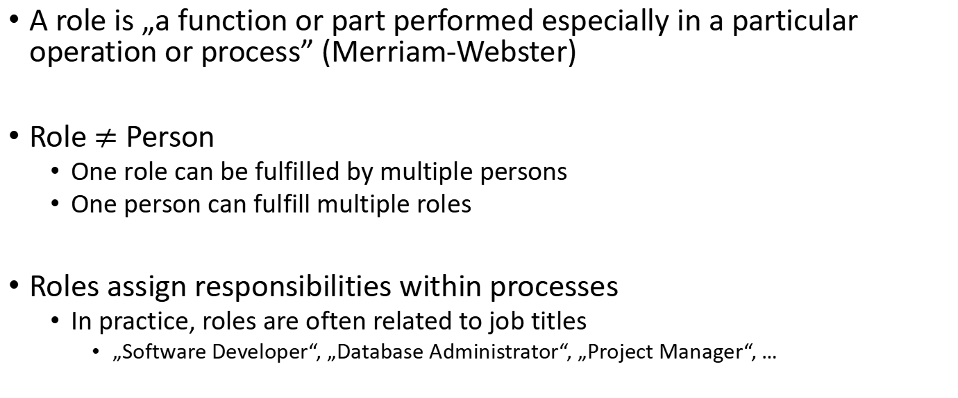
Roles within Projects
A role is „a function or part performed especially in a particular operation or process” (Merriam-Webster)
Role $≠$ Person
One role can be fulfilled by multiple persons
One person can fulfill multiple roles
Roles assign responsibilities within processes
In practice, roles are often related to job titles
„Software Developer“, „Database Administrator“, „Project Manager“, …

Slide 29







Roles for Data Science Projects
Role | Description
Business User | Someone who uses the end results Can consult and advise project team on value of end results and how these will be operationalized
Project Sponsor | Responsible for the genesis of the project Generally provides the funding Gauge the value from the final outputs
Project Manager | Ensure key milestones and objectives are met on time and at expected quality Plans and manages resources
Business Intelligence Analyst | Business domain expertise with deep understanding of the data Understands reporting in the domain, e.g., Key Performance Indicators (KPIs)
Data Engineer | Deep technical skills to assist with data management and ETL/ELT
Database Administrator | Provisions and configures database environment to support the analytical needs of the project
Data Scientist | Expert on analytical techniques and data modeling Applies valid analytical techniques to given business problems Ensures analytical objectives are met

Slide 30


















Slide 31
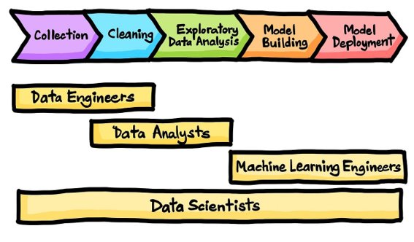
Roles and tasks

Slide 32
Outline
Generic Process Model
Roles
Core Deliverables
Summary

Slide 33
Deliverables
A deliverable is a tangible or intangible good or service produced as a result of a project.
Are often parts of contracts
Should meet stakeholder‘s needs and expectations
Four core deliverables for data science projects
Sponsor presentation
Analyst presentation
Code
Technical specifications

Slide 34
Sponsor Presentation
„Big Picture“ of the project
Clear takeaway messages
Highlight KPIs
Should aid decision making
Should address a non-technical audience
Clean and simple visualizations
For example, bar charts, line charts, …

Slide 35
Analyst Presentation
Describe analysis methods and data
General approach
Interesting insights, unexpected situations
Details on how results change current status
Business process changes
Advancement of the state of the art
May use more complex visualizations
For example, density plots, histograms, boxplots, ROC curves, …
Should still be clean and not overloaded

Slide 36
Code and Technical Specification
All available code of the project
Often code is prototypical („hacky“) because results are more important than clean code
Enables operationalization
May re-use code as is
May adopt code or clean up code
May rewrite same functionality in a different language/for a different environment
Technical specification should be provided as well
Description of the environment
Description of how to invoke code

Slide 37
Expected Deliverables by Role
Role | Deliverable
Business User | Expects a sponsor presentation: Are the results good for me? What are the benefits for me? What are the implications for me?
Project Sponsor | Expects a sponsor presentation: What is the impact of operationalizing the results? What are the risk and what is the potential ROI? How can this be evangelized within the organization (and beyond)?
Project Manager | Responsible for the timely availability of all deliverables Responsible for the sponsor presentations
Business Intelligence Analyst | Expects an analyst presentation: Which data was used? How will reporting change? How will KPIs change?
Data Engineer | Responsible for data engineering code and technical documentation
Database Administrator | Responsible for infrastructure code and technical documentation
Data Scientist | May be the target audience for analyst presentations. Responsible for data analysis code and technical documentation Responsible for the analyst presentation Support of the project management with the sponsor presentation

Slide 38
Data as Deliverable
Only applicable if new data was collected/generated
Sharing the data may be very important
Especially in research to enable reproducible and replicable research
Sharing may be internal (industry) or public (research)
Use stable links for references to prevent link rot
Ideally Digital Object Identifiers (DOIs)
Should not only contain the data, but also metadata and tools for collecting the data

Slide 39
Outline
Generic Process Model
Roles
Core Deliverables
Summary

Slide 40
Summary
Generic process for data science projects with six phases
Discovery, data preparation, model planning, model building, communication of results, and operationalization
Different actors in different roles involved in project
Expectations depend on role
Four core deliverables fulfill most stakeholder needs
Sponsor presentation, analyst presentation, code, technical specification
Data may also be a deliverable

